Slide 1


Campus Canteen
Pre Order System
ONLINE FOOD PRE-ORDERING & MANAGEMENT SYSTEM
Team Name: Team Elevate
Track: Open

Slide 2
Topics to be covered
Sr No. | Topic
1 | Project Profile & Technology
2 | Problem Statement
3 | Aims And Objective
4 | Feasibility Analysis
5 | Core Module
6 | Diagram (Class,Use Case,Activity)
7 | Data Dictionary
8 | System Testing
9 | System Screens / Interface Layout
10 | Future Enhancement

Slide 3
Project Profile & Technology
System Information
Software Stack
Application Type: Responsive Web Application
Platform: Web Browser
Primary Goal: Automate the food ordering process
Target: Students, Canteen Staff, University Staff
Front-End: HTML5, CSS3, JS
Back-End: PHP
Database: MySQL
Server: Apache via XAMPP Environment

Slide 4
Problem Statement
Existing System
Proposed System
Long queues during break time
Manual order talking
No pre-order facility
Time-consuming process
Chances of order mistakes
  Online food pre-order system
  Real-time menu display
  Secure login system
  Order tracking system
  Admin panel for management
  Digital record maintenance

Slide 5
Aims and Objectives
The main aim of the Campus Canteen Pre-Order System is to develop a web-based platform that allows students to order food online in advance, reduce waiting time in queues, and improve the efficiency of canteen operations.
Objectives:
To provide students with an easy and convenient way to pre-order food online.
To reduce long queues and crowds at the campus canteen during break times.
To minimize manual errors in taking and preparing food orders.
To enable students to view menu items, prices, and availability in real time.
To help the admin manage food items, order payments, and users efficiently.
To maintain digital records of orders and transactions for better tracking.
To improve the overall speed, accuracy, and user experience of the canteen service.

Slide 6
Feasibility analysis
Operational Feasibility:
  The system is easy to use for students, staff, and admin.
  It reduces manual work and makes food ordering faster and more convenient.
Technical Feasibility:
  The system is built using PHP, MySQL, HTML, CSS, and JavaScript.
  It can run on standard devices and browsers without requiring high-end hardware.
Economical Feasibility:
  The system is cost-effective because it uses open-source technologies.
  It reduces paperwork, saves time, and improves canteen efficiency.

Slide 7
Core Module
Authentication
Secure student/admin login, registration, password protection, and user access control.
Menu & Order
Display food items, allow pre-order placement, quantity selection, and order confirmation.
Admin Panel
Manage menu items, users, orders, payments, and monitor overall canteen activities.
Report
Generate order records, payment details, sales summary, and daily transaction reports.

Slide 8
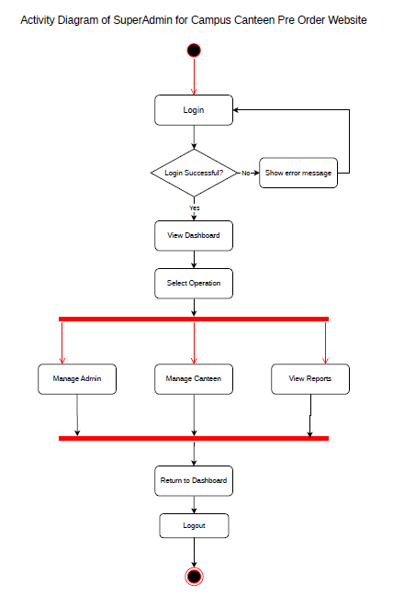
SuperAdmin Activity Diagram:

Slide 9
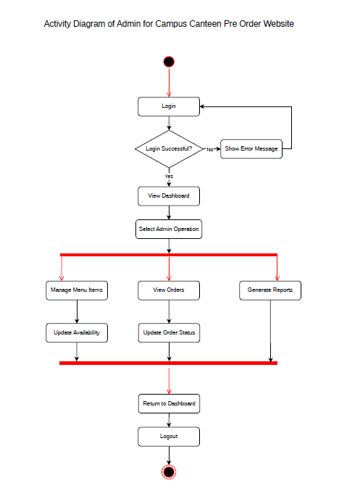
Admin Activity Diagram:

Slide 10
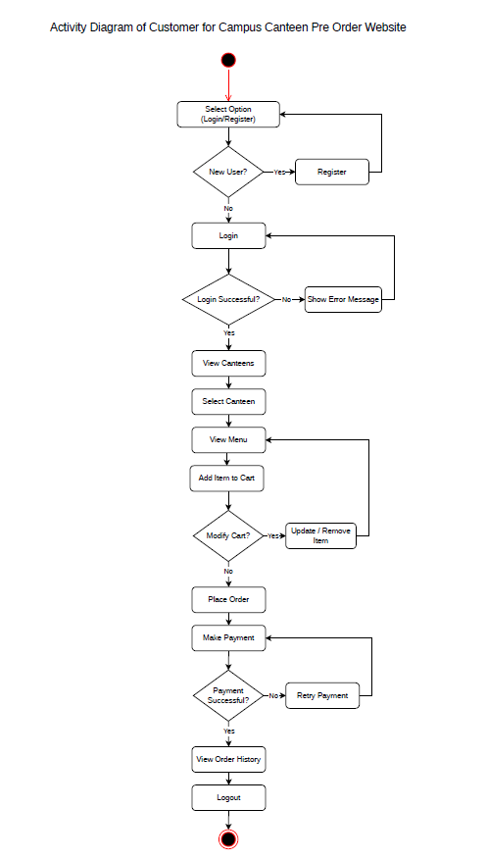
Customer Activity Diagram:

Slide 11
Team: Team Elevate
Member | Role | Contribution
Nandni Patel | Team Lead / Backend & Integration Developer | PHPMailer integration, backend functionality
Naiya Patel | Problem & Presentation Lead | Problem, Solution & PPT
Nishtha Patel | Documentation Lead | Documentation & Architecture
Siya Pabari | Frontend & Code Lead | Source code

Slide 12
THANK YOU!

